Slide 1
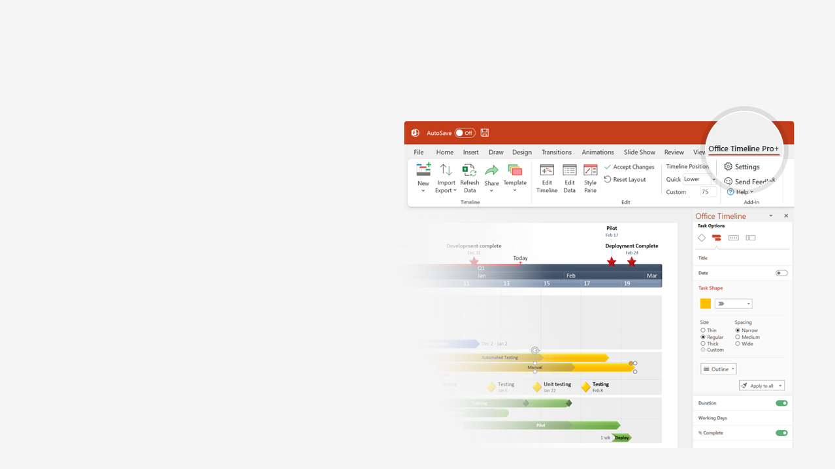

How to update this template in seconds
The Office Timeline add-in for PowerPoint will help you edit it with just a few clicks.
Get your free 14-day trial of Office Timeline here:
https://www.officetimeline.com/14-days-trial
Re-open this template, and create your impressive
PowerPoint visual in 3 easy steps:
1
Click the Edit Data button on the Office Timeline tab.
2
Use the Data and Timeline views to edit swimlanes, milestones and tasks.
3
Click Save to instantly update the template.

Slide 2



Dec 26 - Dec 27
Dec 10 - Dec 13
Dec 29 - Dec 30
Dec 17 - Dec 18
Jan 5 - Jan 8
14872 days
Jan 2 - Jan 2
2873 days
784 days
785 days
783 days
262 days
Dec 27
Dec 18
Dec 19
Dec 20
Dec 22
Dec 11
Dec 25
Dec 28
Dec 14
Dec 21
Jan 4
Jan 3
Dec 7
Dec 8
Dec 9
Jan 2
Dec 6
Dec 7
1948
2037
Today
BATTLE OF YAVIN (YEAR ZERO)
1948
|50 BBY
|40 BBY
|30 BBY
|20 BBY
|10 BBY
|0 ABY
|10 ABY
|20 ABY
|30 ABY
1957
1966
1975
1984
1993
2002
2011
2020
2029
Star Wars Episode I: The Phantom Menace (32 BBY)
Prequels
Star Wars Episode II: Attack of the Clones (22 BBY)
Star Wars Episode III: Revenge of the Sith (19 BBY)
Star Wars timeline
Star Wars Episode IV: A New Hope (0 ABY)
EPISODES (I-IX)
Originals
Star Wars Episode V: The Empire Strikes Back (3 ABY)
Star Wars Episode VI: Return of the Jedi (4 ABY)
Star Wars Episode VII: The Force Awakens (34 ABY)
Sequels
Star Wars Episode VIII: The Last Jedi (34 ABY)
Star Wars Episode IX: The Rise of Skywalker (35 ABY)
Other Movies
Star Wars: The Clone Wars Movie (22 BBY)
Rogue One: A Star Wars Story (0 ABY)
Solo: A Star Wars Story (13-10 BBY)
Star Wars: Tales of the Jedi (40-19 BBY)
Star Wars: Rebels (5 BBY)
The Mandalorian (9-12 ABY)
TELEVISION SERIES
Star Wars Forces of Destiny Anthology Series (22 BBY - 35 ABY)
Star Wars: The Clone Wars Series (22-19 BBY)
Star Wars: Resistance (34-35 ABY)
Obi-Wan Kenobi (9 BBY)
The Book of Boba Fett (9 ABY)
Star Wars: The Bad Batch (19 BBY)
Andor (5 BBY)
Ahsoka (12 ABY)

Slide 3
BATTLE OF YAVIN (YEAR ZERO)
1948
|50 BBY
|40 BBY
|30 BBY
|20 BBY
|10 BBY
|0 ABY
|10 ABY
|20 ABY
|30 ABY
1957
1966
1975
1984
1993
2002
2011
2020
2029
Star Wars Episode I: The Phantom Menace (32 BBY)
Prequels
Star Wars Episode II: Attack of the Clones (22 BBY)
Star Wars Episode III: Revenge of the Sith (19 BBY)
Star Wars timeline
Star Wars Episode IV: A New Hope (0 ABY)
EPISODES (I-IX)
Originals
Star Wars Episode V: The Empire Strikes Back (3 ABY)
Star Wars Episode VI: Return of the Jedi (4 ABY)
Star Wars Episode VII: The Force Awakens (34 ABY)
Sequels
Star Wars Episode VIII: The Last Jedi (34 ABY)
Star Wars Episode IX: The Rise of Skywalker (35 ABY)

