Slide 1
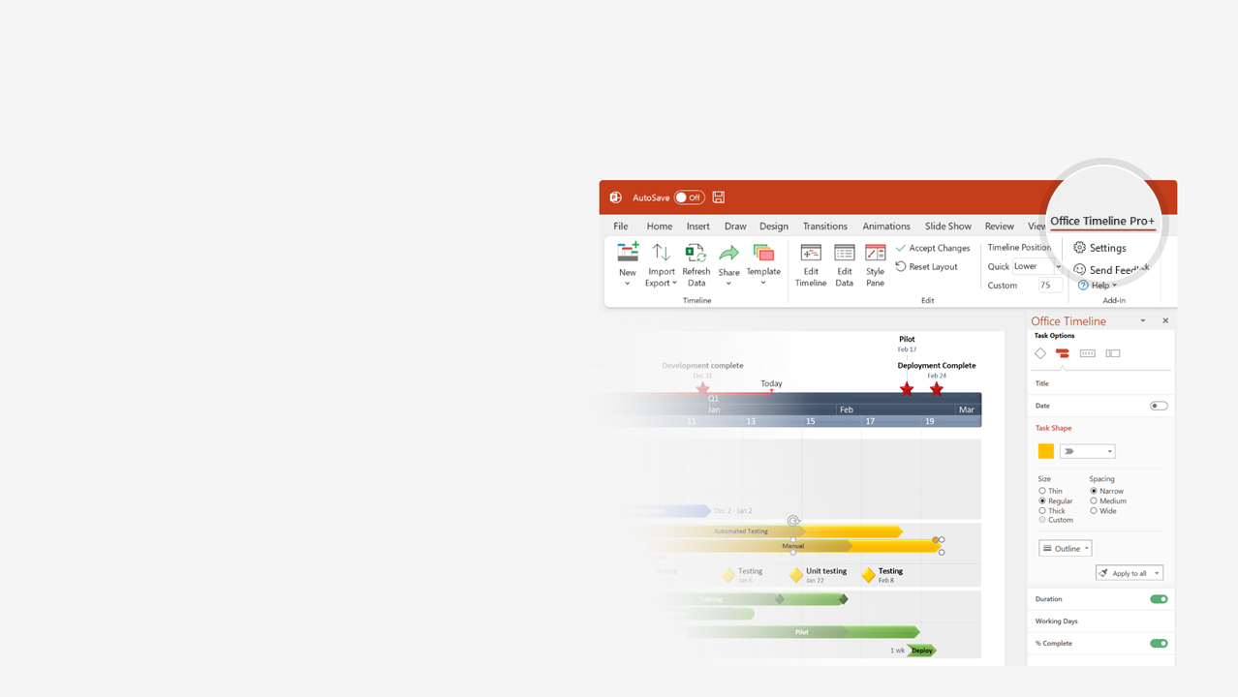

How to update this template in seconds
The Office Timeline add-in for PowerPoint will help you edit it with just a few clicks.
Get your free 14-day trial of Office Timeline here:
https://www.officetimeline.com/14-days-trial
Re-open this template, and create your impressive
PowerPoint visual in 3 easy steps:
1
Click the Edit Data button on the Office Timeline tab.
2
Use the Data and Timeline views to edit swimlanes, milestones and tasks.
3
Click Save to instantly update the template.

Slide 2

Stakeholder Analysis Template
Keep satisfied
Stakeholder 1
Stakeholder 2
Manage closely
Stakeholder 3
Stakeholder 4
Stakeholder 5
Monitor
Stakeholder 6
Keep informed
Stakeholder 7
Stakeholder 8
Stakeholder | Unaware | Resistant | Neutral | Supportive | Leading
Stakeholder 1 | C |  |  | D
Stakeholder 2 |  | C |  | D
Stakeholder 3 |  |  | C
Stakeholder 4 |  |  |  | C
Stakeholder 5 |  |  |  |  | D
Stakeholder 6 |  |  | C | D
C = current
D = desirable
Power
Interest
Product Roadmap
Partner NDAs
Jan
Feb
Mar
Apr
May
Jun
Jul
Aug
Sep
Oct
Nov
Dec
Marketing
Develop
Excite
Ignite
Web App Release
46 weeks
Web app
Product
Mobile App Release
34 weeks
Mobile app
PC App Release
27 weeks
Windows app

